Slide 1
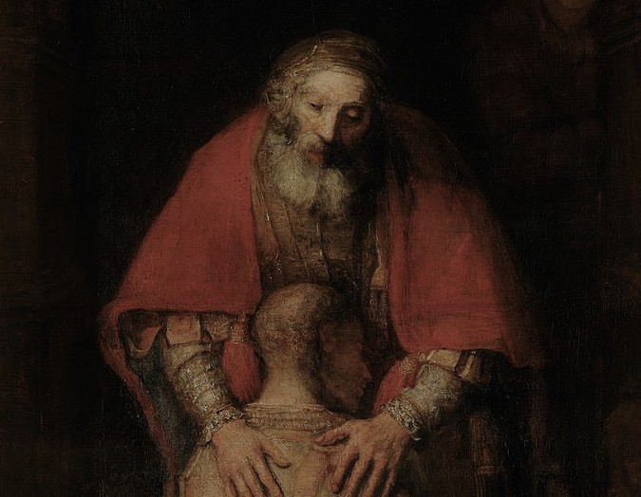
THE MIRACLE of FORGIVENESS
BR. LOUIS DE MONTFO RT, OSB M AY 20, 2023

Slide 2
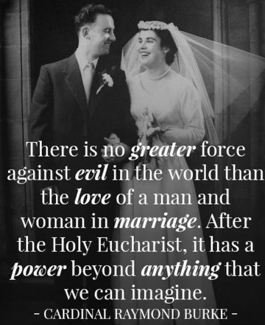

Slide 3
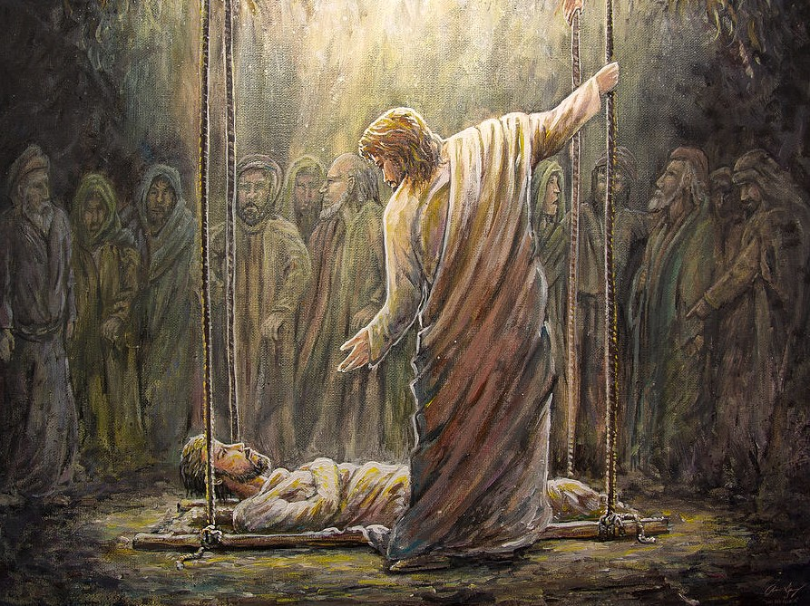
CONFERENCE OUTLINE:
“What is Forgiveness?”: Understanding the Meaning of Forgiveness
“Why Forgive?”: The Importance of Forgiveness
“Christ Forgives”: The Paschal Dimension of Forgiveness
“How to forgive?”: Practical Steps in the Forgiveness Journey

Slide 4
The Miracle of the Healing of the Paralytic

Slide 5
WHAT IS FORGIVENESS:
Understanding the Meaning of Forgiveness

Slide 6
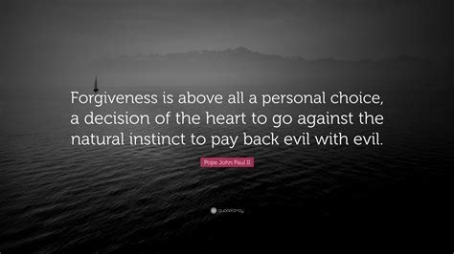

Slide 7
F-o\l' iVU\QA. JoC2A.r\¹f
C2.IXU\ C2.I +kC21i\l'
b AViO\I'.
fo\' iVU\Q.& P"WU\n l-:k " bU\AV.iO\I' f\l'OM JC2A.-f-vo ir\
O \I' kCW'lrt-.
Pic.+i..,,,..e Q1,,,,1ofes. c.0"'1

Slide 8
U@ @[fer B WMUiJD&)ITD9 {k@
a : w,, a B r-,,""i.-..-@

Slide 10
Forgiveness is iust another name tor freedom.
Bvron Katie
nnarr1age.com

Slide 11
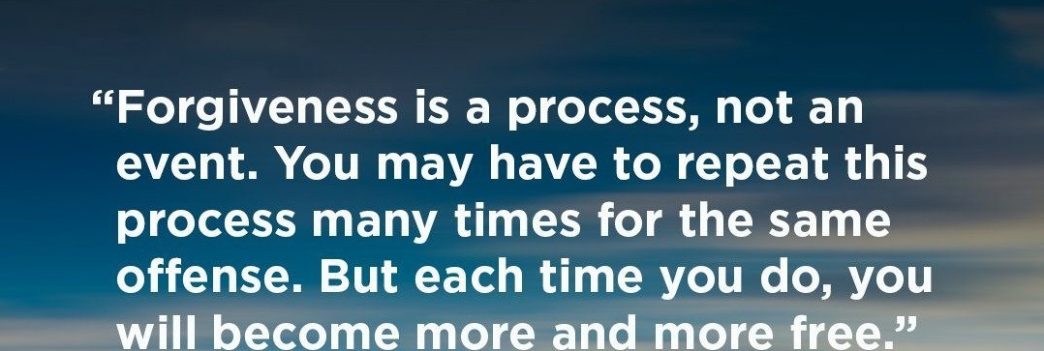
..,..,..,_

Slide 13
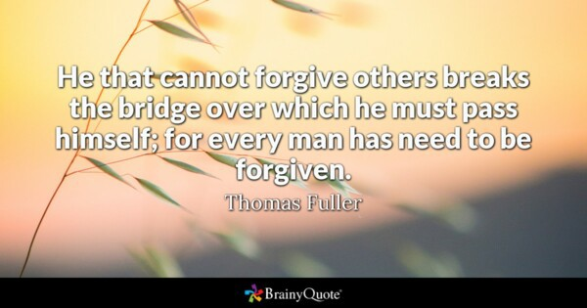

Slide 15
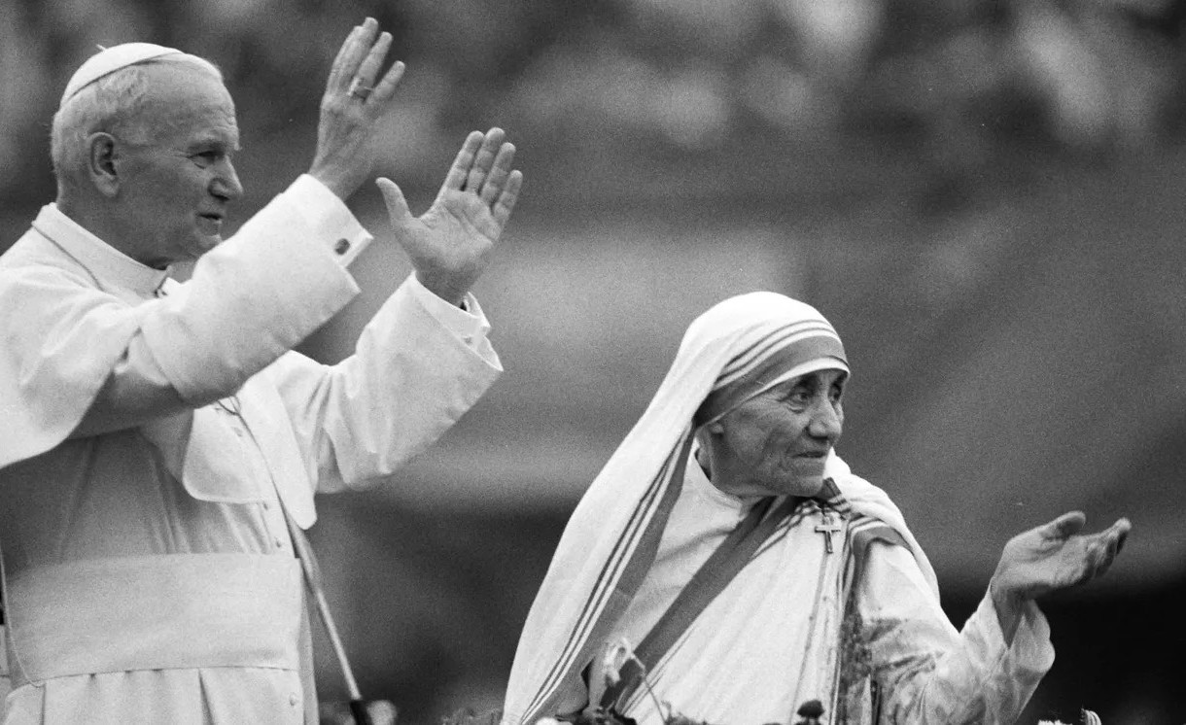
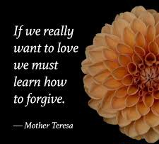

Slide 16
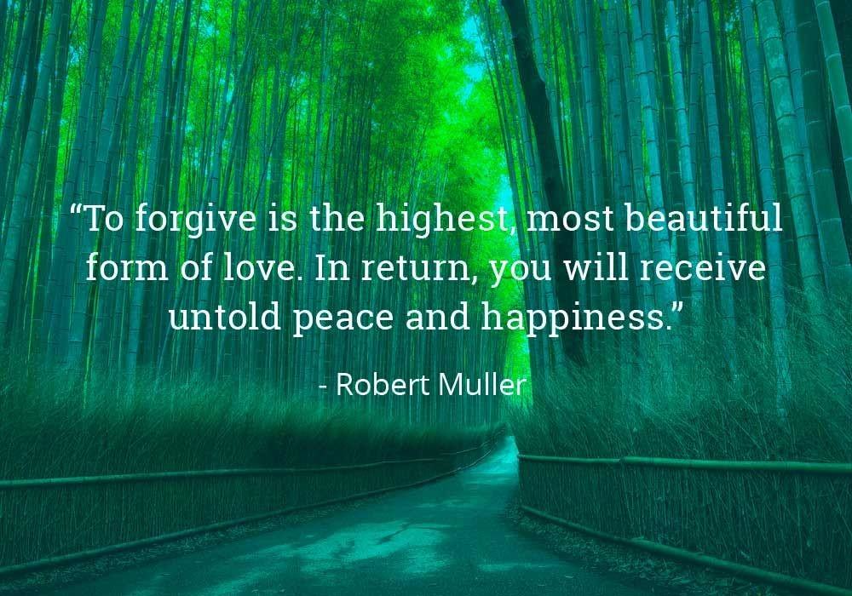

Slide 17
WHY FORGIVE?
The Importance of Forgiveness

Slide 18
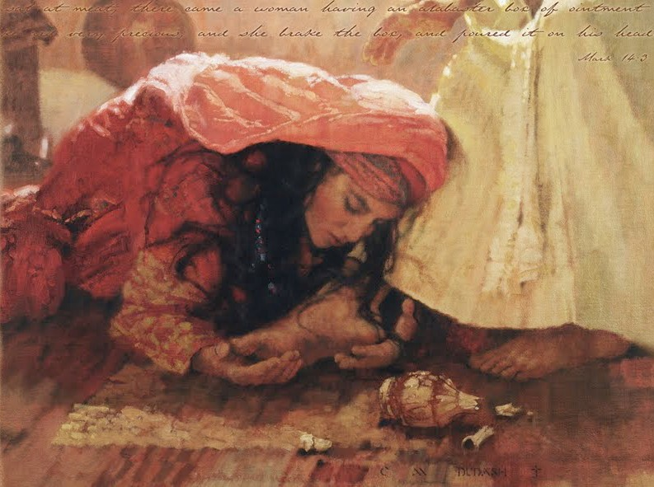
FORGIVENESS & THE NEW CREATION
“The forgiveness of sinners is a greater work than the creation of heaven and earth or the creation of the angels in justice and purity…
in that the forgiveness of sinners bears witness to a greater Love”
(that we call Mercy) c.f. CCC #1994

Slide 20
CHRIST FORGIVES:
The Paschal Dimensions of Forgiveness

Slide 21
Jesus Forgives the Sinner

Slide 22
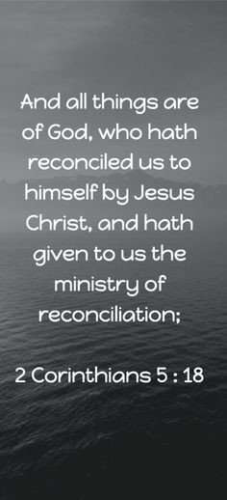

Slide 23
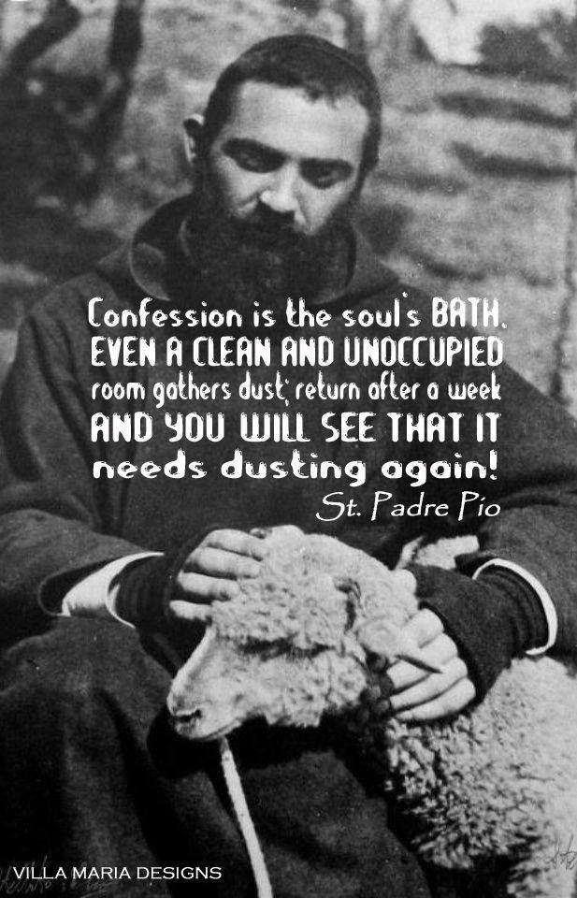

Slide 25
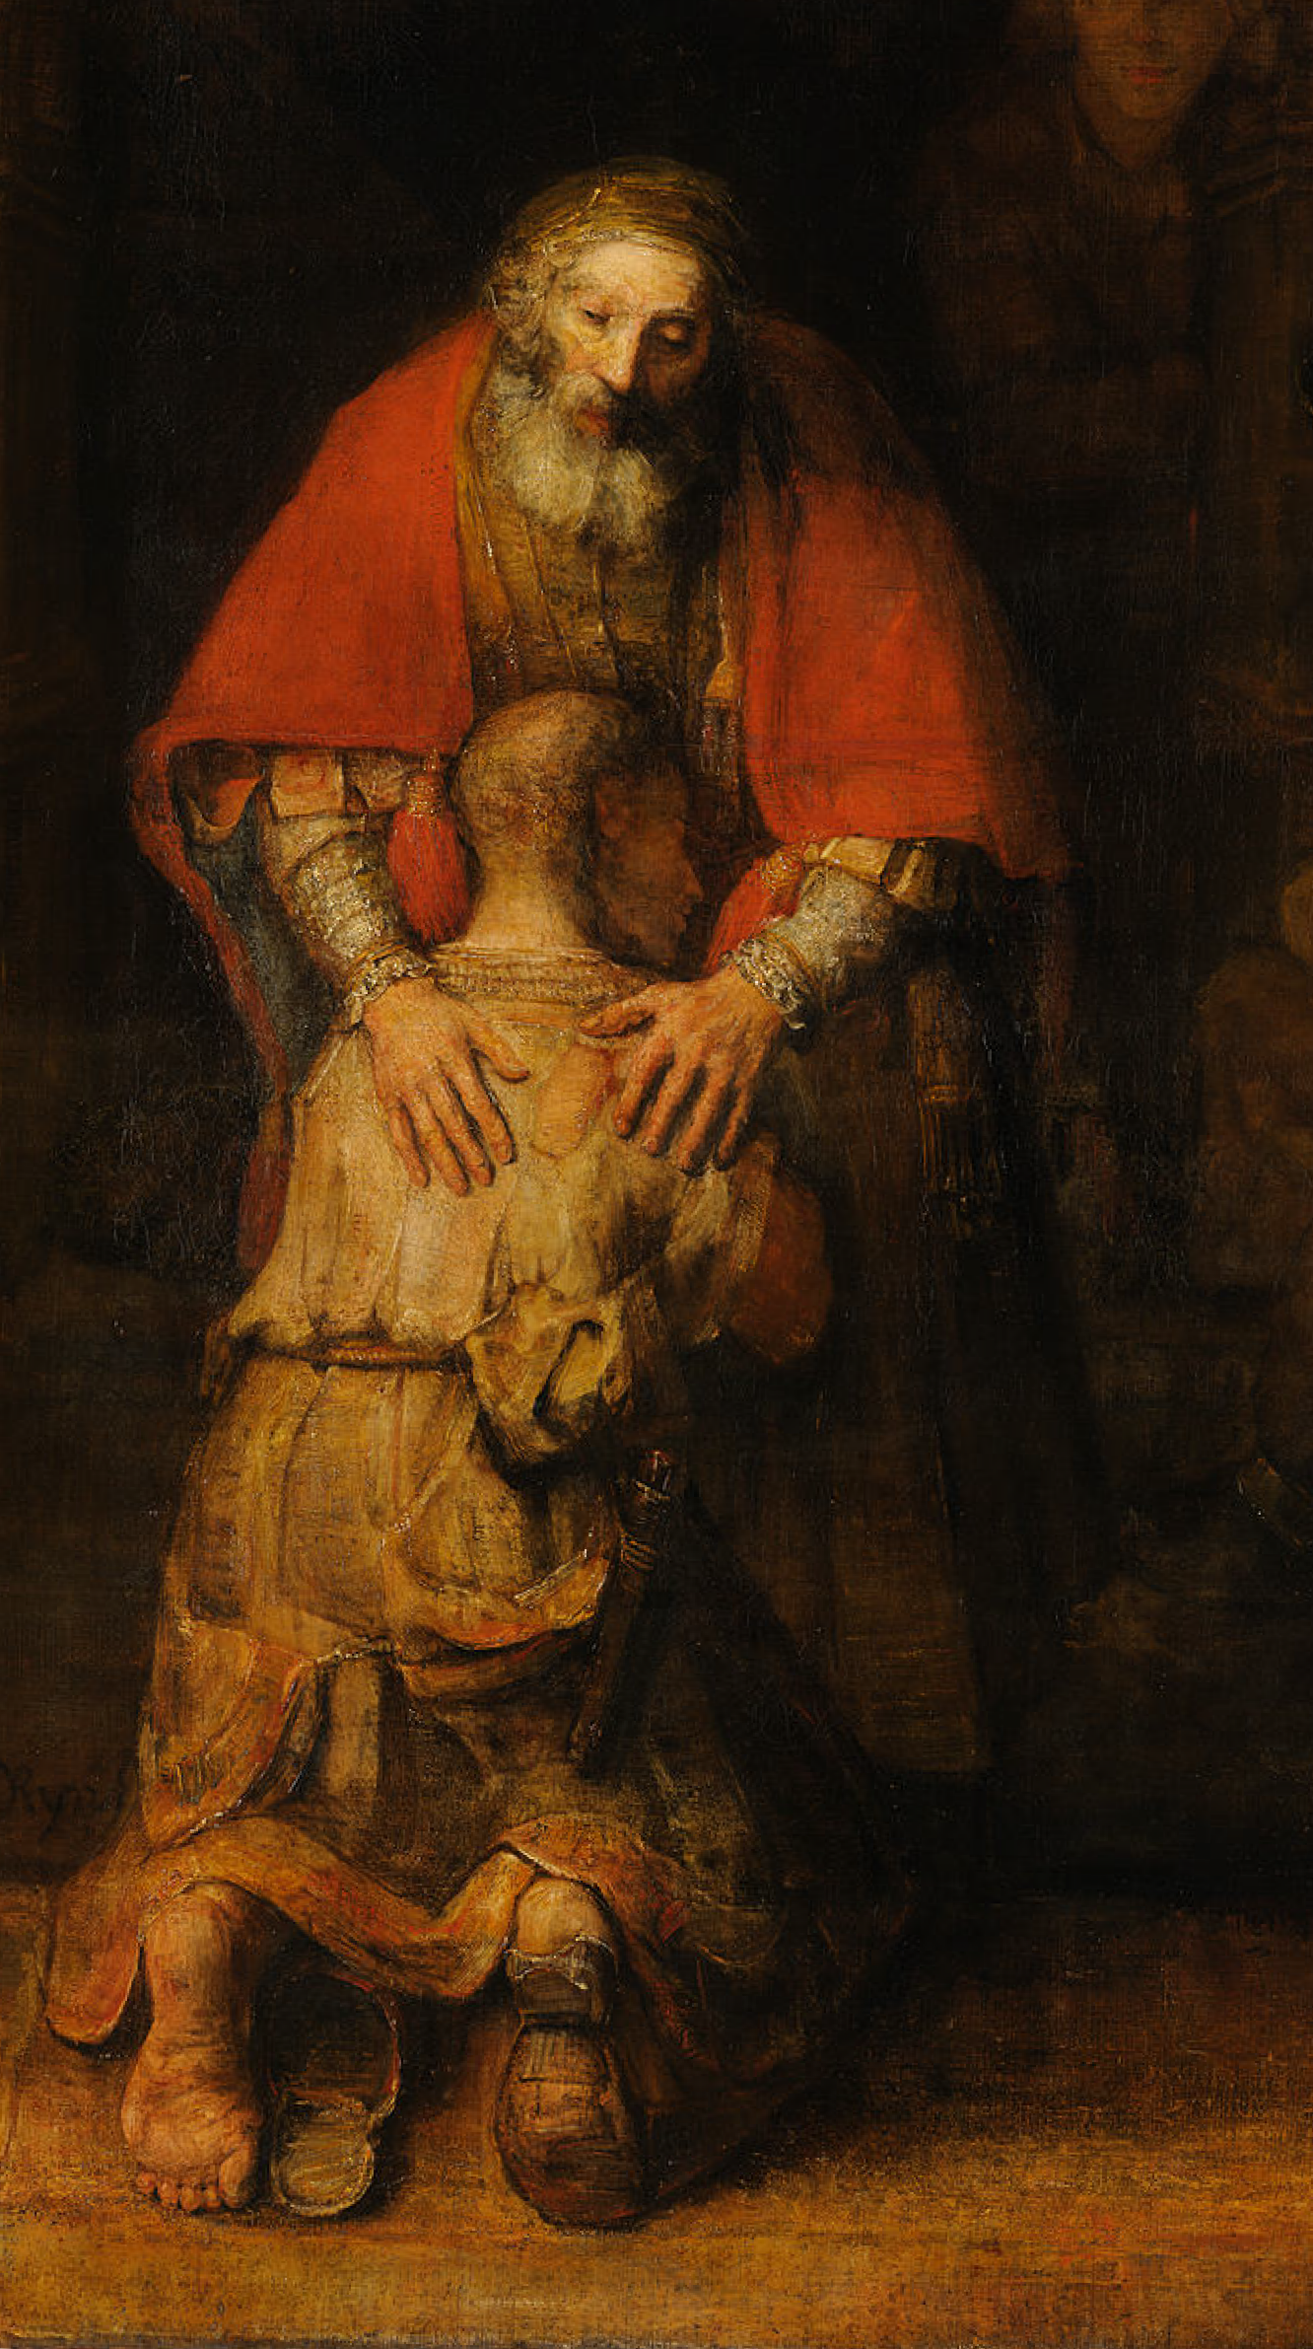
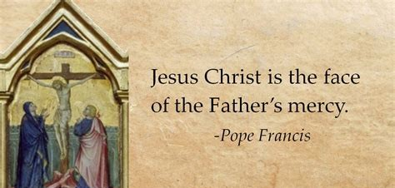

Slide 26
HOW TO FORGIVE?
The Practical Steps in the Forgiveness Journey

Slide 28
TAKE AWAY Points:
Forgiveness is Divine. A gift from God.
Forgiveness is a necessary medicine for a broken relationships, broken spouses.
The more forgiveness we receive from God, the more forgiveness we can share with others.
Forgiveness is an act of God, working in us, through us, with our cooperation.
To forgive is to be like God. When we forgive, we become like God, more like the Image of Christ.
Forgiveness is a manifestation (epiphany) of God’s highest & deepest love: Mercy.
Hurts and wounds are INVITATIONS to share in the Paschal Mystery of Christ.
*Some of the most powerful stories of forgiveness are in the Gospels. Therefore, we should read and meditate on Scripture and the Gospels

Slide 29
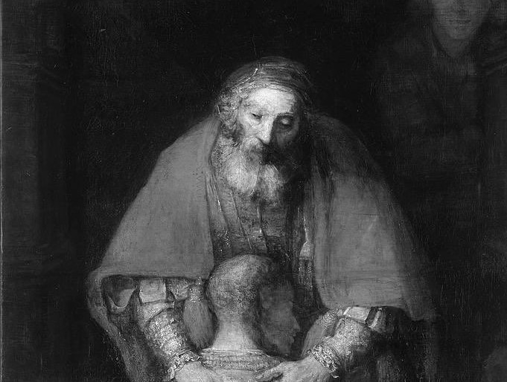
Resources on Forgiveness:
​PRAYERS:
-Psalm 51
-Surrender Novena
-Litany of Humility
​Books:
-“Everybody Need to Forgive Somebody” by Allen Hunt
“How to Forgive Yourself and Others: Steps to Reconciliation” by Father Tobin
“Be Healed: A Guide to Encountering the Powerful Love of Jesus in Your Life" by Bob Schuchts
3. Podcasts:
-“Restore the Glory” by Bob Schuchts

Slide 30
Resources on Forgiveness:
​Bible Stories on Forgiveness
-healing of the paralytics let down from the roof. -Mark 2:1-12
-Zacchaeus Luke 19:1-10
-a woman caught in adultery forgiven by Jesus. -John 8:1-11
-You must forgive seventy times seven (seventy-seven times); Matt 18:21-35
-Anointing of Jesus with wine by the Sinful Woman - Luke 7:36-50
-Healing of the blind in two stages- Mark 8:22-26
-forgiveness of Peter -Luke 22:54-65
-forgiveness of Judas -Luke 22: 47-51
-Jesus forgiving on the Cross -Luke 23:33-43
-Prodigal Son -Luke 15:11-32
-Cross: Father Forgive them. I have forgiven you (sinners of Christ)- Luke 22:33-43
-Genesis 37-50- Story of Joseph of Egypt
Absalom’s death- 2 Samuel 18
Genesis 8:6-13, 20-22: Noah; the Dove and olive branch; reconciliation; peace;
Gen 6:5-8 God regrets during the time of Noah

