Slide 1
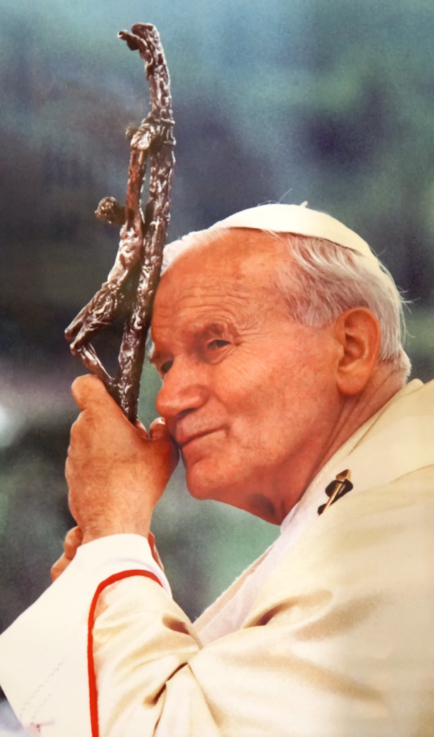
Marriage fully alive
How the theology of the body can transform you and help you have a magnificent marriage
2 Become 1 Retreat for Married and Engaged Couples
Mt. Angel Abbey
26 May 2023
This Photo by Unknown Author is licensed under CC BY-SA

Slide 2
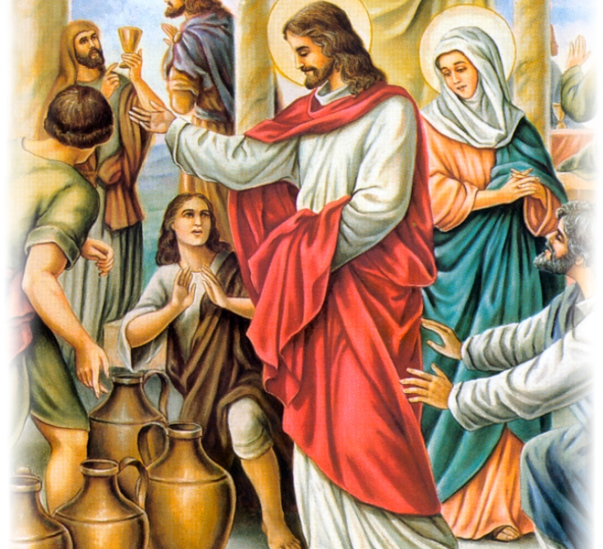
A Noble Vocation – A Sacrament of Redemption
This Photo by Unknown Author is licensed under CC BY-NC-ND
This Photo by Unknown Author is licensed under CC BY-NC-ND

Slide 3
Theology of the Body
5 September 1979 – 28 November 1984; 5 years, 133 Lessons
Part I: The Words of Christ (1-86)
Part II: The Sacrament (87-133)

Slide 4
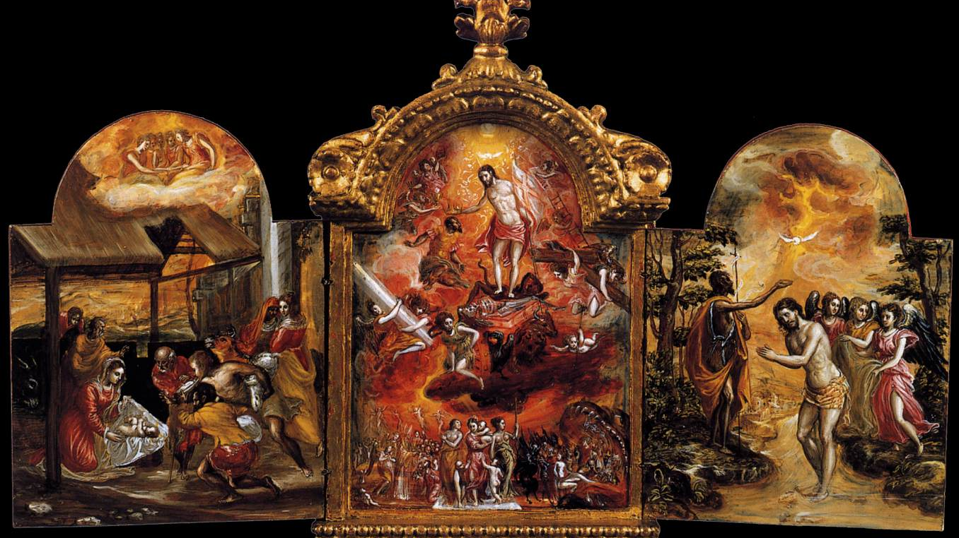
The Triptych
This Photo by Unknown Author is licensed under CC BY-SA

Slide 6
Christ’s Appeal to the Beginning Matthew 19:3-8
Talking with the Pharisees
“Because of your hardness of heart…but from the beginning it was not so.”
Original plan of the Creator – original solitude
Walked with God
Identity as beloved son or daughter made in His image
Communion of Persons – original unity
Nuptial mystery: Flesh of my flesh and bone of my bones - joy
Naked without shame
Goodness, Justice, Beauty, Truth, and Love
:: Truth of Love

Slide 7
Sin
The Hook: “Is it true”
The Lie: ”You will not die”
The Bait: good for food, pleasing to the eyes desirable to make one wise
The Consequence: Separation. Isolation. Distortion of the Father’s plan
“Where are you?”

Slide 8
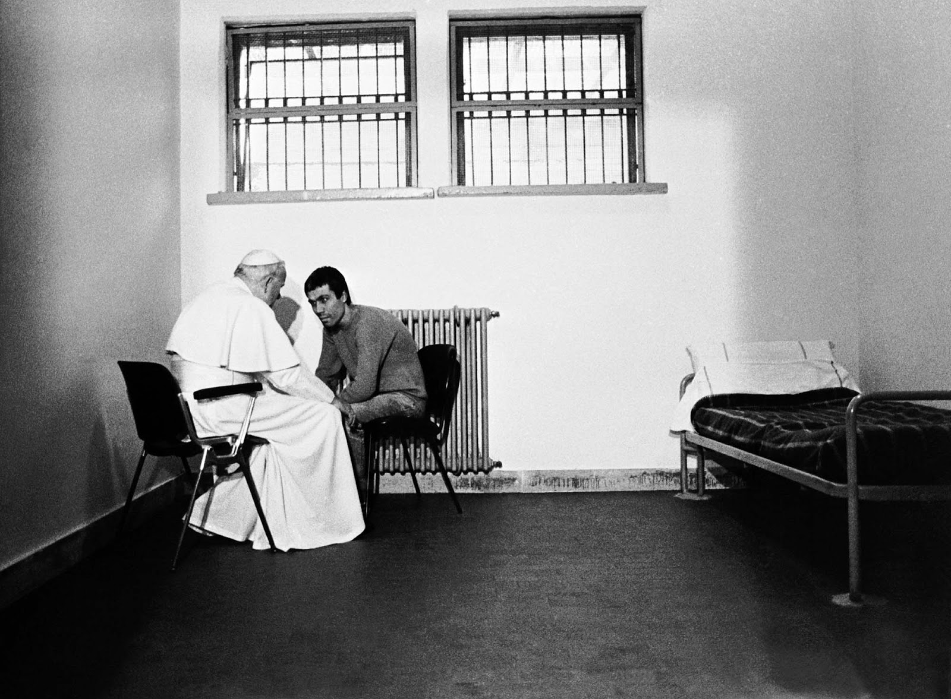
Crucial conversation - What makes you fall in love with your fiancé/spouse? What convinces you about their love? - What puts a distance in the relationship between you and the one whom your soul loves?
This Photo by Unknown Author is licensed under CC BY-SA-NC

Slide 9
Christ’s Appeal to the Human Heart Matthew 5:27-28
Talking with the disciples
Sermon on the Mount: beatitudes, salt of the earth and light of the world, you have heard it said…
Christ came not to accuse the human heart but to call the human heart back to the Father’s original plan: Repent and believe the Gospel
Sin distorted the Creator’s plan but didn’t destroy His original intention
Jesus the Divine Healer: Knows the Fathers plan
”The Father Loves the Son” John 5:20
”To seek and save the lost”. I’ve come to find you.

Slide 10
Healing wounded hearts Pain Lies Inner vows (K&S)
Mary Magdalene
Matthew
Woman at the Well
Woman caught in adultery
Paralyzed man lowered through roof
Man at pool of Siloam
You and me…
This Photo by Unknown Author is licensed under CC BY-NC

Slide 11
Jesus calls his disciples to a new way of life purity of heart, demanding but possible

Slide 12
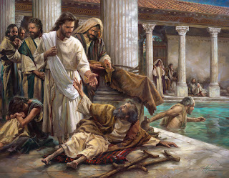
Crucial conversation – Letting the divine physician touch our wounded hearts
What is the deep pain of my heart?
What are lies I believe about God/myself/others?
What are some of the inner vows I have made that keep me from being vulnerable?
This Photo by Unknown Author is licensed under CC BY-NC-ND

Slide 13
Christ appeals to the Resurrection Mark 12:20-27
Talking with Saducees
“Who’s wife will she be?”
“You know neither the Scriptures nor the power of God…He is not God of the dead but of the living…you are quite wrong”
Spiritualization of man
Communion of Persons
Perfection of the Father’s plan
I’ve found you: ”We must rejoice…My son who was dead has come to life again. He was lost and now he is found”

Slide 14
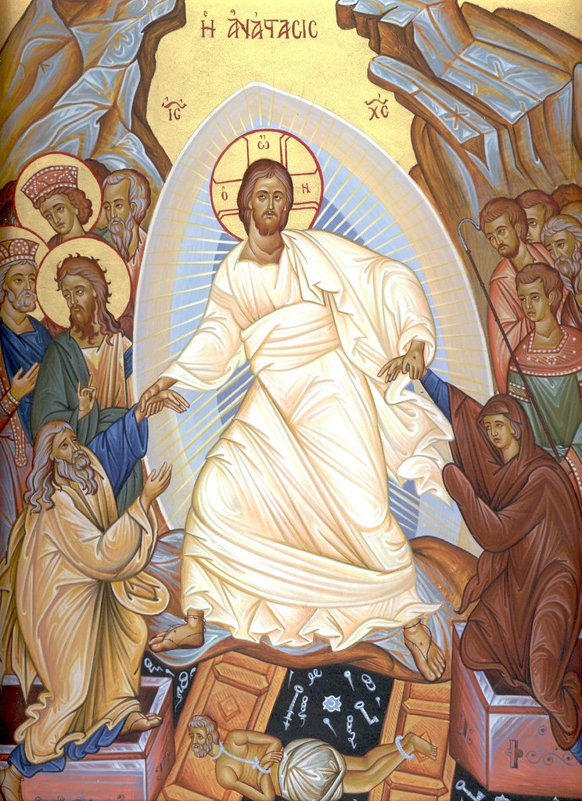
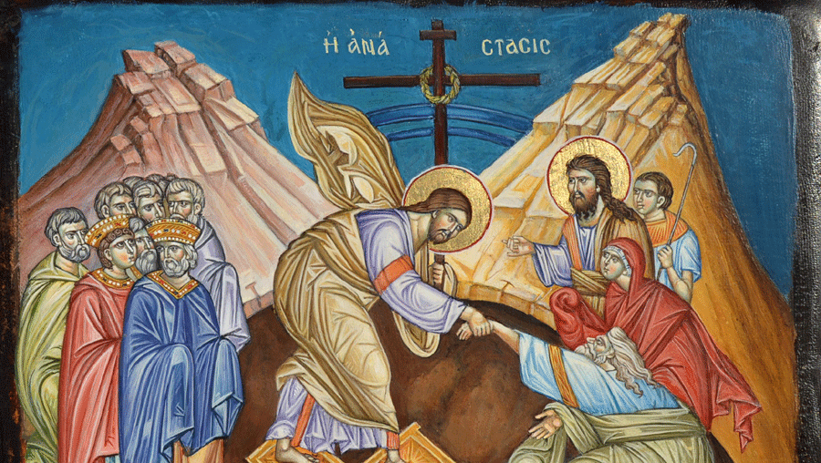
Death not the end: Marriage the sign of the divine reality – Ephesians 5
This Photo by Unknown Author is licensed under CC BY-NC-ND

Slide 15
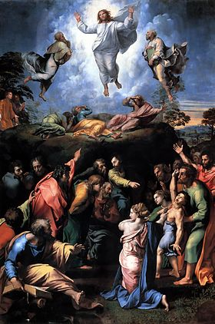
Crucial Conversation
How do I make a gift of myself now?
Where am I in need of letting Christ transform me?
How can I give myself to fiancé/spouse when we are relationally distant?
This Photo by Unknown Author is licensed under CC BY-SA

Slide 16
Conclusion: Two points

Slide 17
The truth of love is beautiful

Slide 18
Where did I come from, where am I going?
This Photo by Unknown Author is licensed under CC BY-NC-ND

