Slide 1
Lifetime of Love

Slide 2
Why Marriage - What is it for?
Institutional Family
Primary goals: stability, security
Based on kinship, children, community ties, economics
Psychological Family 1920’s
Primary Goals: satisfaction of individual family members
Based on personal achievement, and happiness
The Pluralistic Family 1970’s
Primary Goals: flexibility, personal satisfaction
Based on the idea that there is no ideal family form and all forms should be supported by the broader society

Slide 3
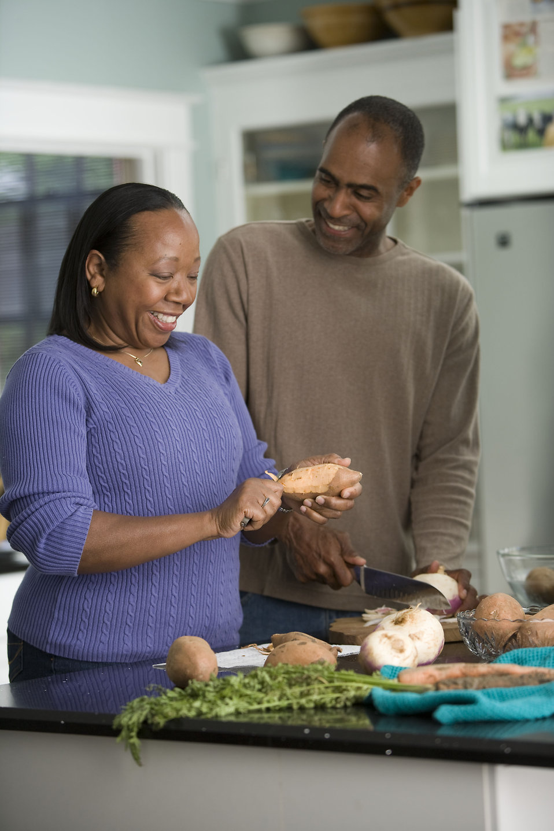
Sacramental Marriage - Sacramental Family
Primary Goals: The good of the spouses, procreation and nurturing of children
Based on: God’s plan for human life, and love, a vocational call to be united with God on earth and forever in heaven.

Slide 4
Sacramental Vows
Free
[Name] and [Name], have you come here to enter into Marriage without coercion, freely and wholeheartedly?
Faithful
Are you prepared, as you follow the path of Marriage, to love and honor each other for as long as you both shall live?
Fruitful
Are you prepared to accept children lovingly from God and to bring them up according to the law of Christ and his Church?

Slide 5
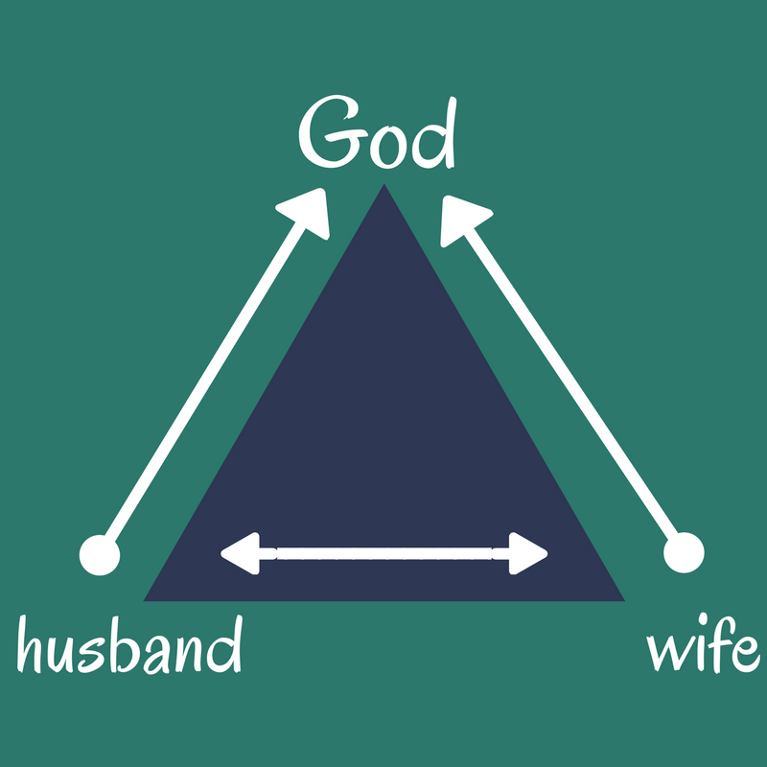
Sacramental Model of Marriage
Sacrament
Contract
Husband Wife
Notes:
Ask for examples of external stressors that can break a marriage
Share our personal story - our witness of God being present in our marriage (Ainsley)

Slide 6
A Sacrament - A Sanctifying Remedy Against Sin
Joy, Gift, Love
Pain, Suffering, Growth
Notes:
All marriages have Summers and Winters

Slide 7
Questions
What do I believe the primary goals of marriage are?
What do we as a couple want the model for our marriage to be?
How have I experience God in our marriage / relationship?
Discuss how the sacramental view of marriage is different from the contract view and what does that mean for your marriage?
Review the Spiritual Beliefs section of your Prepare and Enrich

Slide 8
Communication
Communication is Curiosity
We cannot be fearful & curious at the same time. We cannot have effective communication when we are fearful.
Responsive communication
I respond to you, answer a question, offer solutions, fix it
Receptive communication
I receive you, I listen with empathy, I want to understand your wants, wishes, desires, needs.

Slide 9
Notes:
Watch as this husband moves from responsive listening to receptive listening

Slide 10
Ritual Building and Types of Communication
Develop Rituals for different types of communication
Business Meetings
Finances, chores, calendars, priorities
Responsive - Problem Solving
Identify the problem
Identify the variables
Share possible solutions
Choose a solution to try
Set a date to review the effectiveness of the solution
Receptive Dates
Sharing stories, dreaming together, reminiscing, sharing new personal insights
Notes:
We get closer to one another through rituals - We seek to know one another and get closer to one another via communication
Talk about ways to protect creating a ritual - giving permission to tell the kids this is mom and dad time, etc.

Slide 11
Discussion Questions
Review the Communication portion of your Prepare and Enrich. Discuss the specific questions in your growth area.
Also look at the questions included in roles and responsibilities, leisure activities, and the children and parenting sections or other specific to your relationship sections.

Slide 12
Game

Slide 13
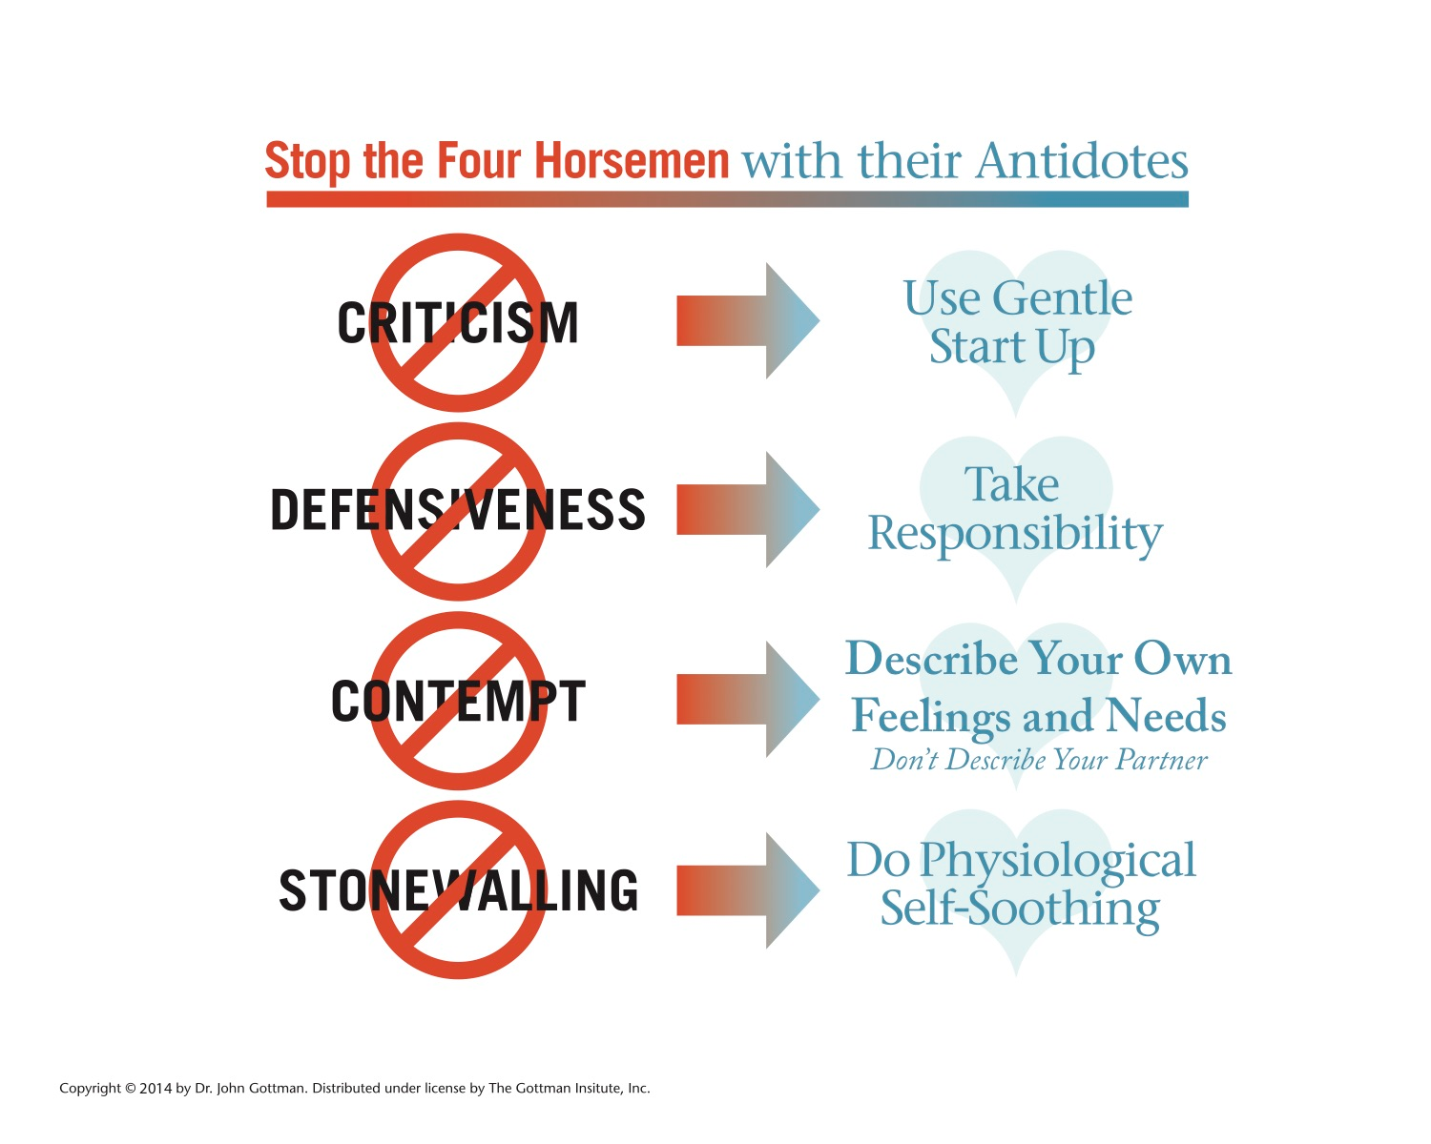
Conflict

Slide 14
Notes:
Communication turns to Conflict

Slide 15
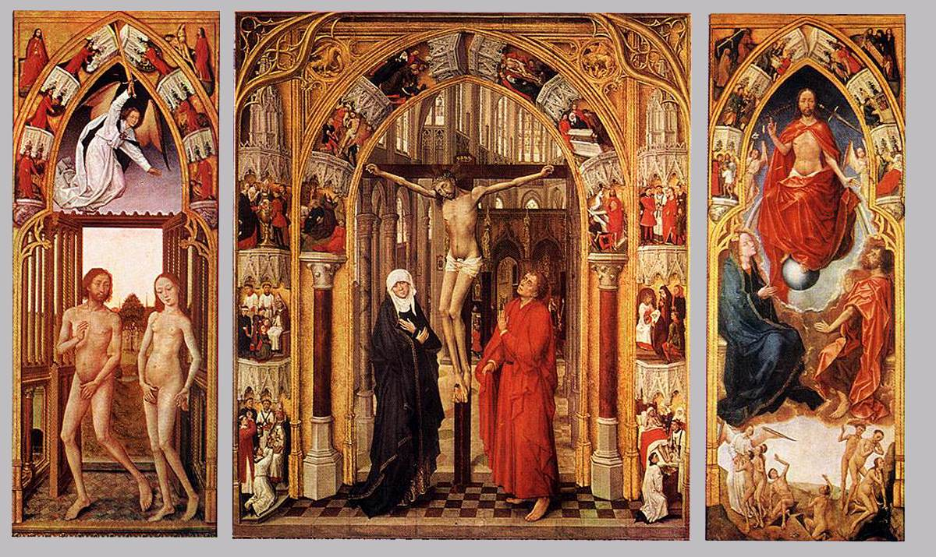
Where did you come from
Where are you going
Notes:
Where did you come from, and where are you going. God gave each of us a life before we met our spouse. Our life experiences before our marriage shape how we see the world the things that we value, and the way we interact with the world. Throughout our marriages our curiosity and conversations will help us process, challenge, question, and even solidify those early life experiences.

Slide 16
Notes:
What should we talk about?? What to ask beyond the business, and raising of kids

Slide 17
Notes:
Stretch Break after this

Slide 19
Brokenness in the Sacred - Renewing Vows
Called to be open to life (fruitful)
Artificial Birth Control
(free, faithful)
Profane to Sacred
Pornography
Masturbation
Extramarital Affairs
History of Abuse
Medications / Health Conditions
Arousal Cycle differences

Slide 20
NFP
Natural Family Planning
FAM
Fertility Awareness Method
Postpartum Depression
Women & Men
Notes:
Here is a quick overview of the female hormone pattern. This pattern is how and why NFP is effective. Here is the hormone fluctuation that is considered fertile, women can not get pregnant before or after this window. NFP is an effective way of identifying this window. It is very effective in helping couples get pregnant, understand and diagnose female health concerns, endometriosis, etc. and it can be effective in helping couples avoid pregnancy when the timing is not right.

Slide 21
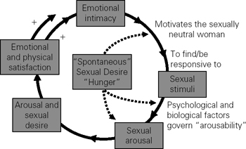
Arousal Cycle
Common Concerns
Timing Babies
Body Changes Postpartum
Postpartum mood disorders (Women & Men)
Privacy, Time, Connection
Menopause
Heart Conditions
Medications
Premature Ejaculation
Erectile Dysfunction
Notes:
Remember that spontaneous desire is most likely to occur during the fertile stage of a woman’s cycle. So it is important to understand that most sexual encounters begin with a sense of emotional intimacy, this comes from that curiousity in our communication. That sense that I am seen, known, and loved. That my spouse wants good for me. For so many women sex has become a bargaining chip, a reward punishment system, or a way to purchase love, something expected of them. So emotional intimacy is a critical step of telling your wife that she is important to you, not that sex is important to you. This can be confusing because there will be times where she is experiencing spontaneous desire. Once emotional intimacy is achieved this is the time to introduce sexual stimuli, backrub, stroking, kissing, etc. this then leads to the arousal cycle. The more this cycle is completed in a way that brings both parties satisfaction the easier emotional intimacy is to initiate next time.

Slide 22
Menopausal Changes
Notes:
Okay remember that cycle of becoming aroused, as women move into perimenopause and then meopause their estrogen levels decrease dramatically, leaving less natural lubrication. For women this is a time full of mixed emotions, the hormonal cycles she is used to are changing, they are all over the place leaving her not knowing what tomorrow will bring, their are the emotions related to the end of fertility, and the feelings surrounding life and death that accompany this next stage of life. This is often also a time when men’s health is changing, and husbands may be less mobile, they may begin to experience erection challenges due to heart and other health conditions. This is a time to double down on emotional intimacy. And for those of you early on in your marriage developing a way of discussing your fertility and sexual experiences makes this transition so much easier, and allows this to be a time of feeling loved and seen for both husband and wife. Rather than scared, angry, hurt, and alone.

